Slide 1

Zim - desktop wiki
http://zim-wiki.org/
19 September 2015
Software freedom day - NLLGG
Jaap.Karssenberg@gmail.com

Slide 2
Contents of this presentation
Introduction
  What is zim
Part 1: different ways to organize
  Per topic, as a journal, etc.
  Full project & GTD flow
Part 2: customize zim to your own work flow
  Working with files
  Custom scripts & Plugins

Slide 3
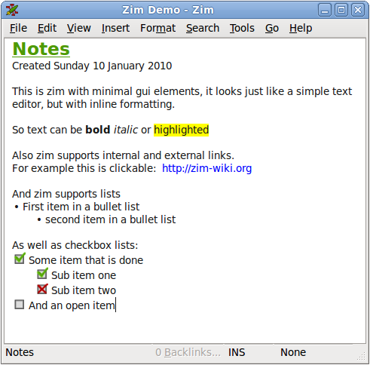
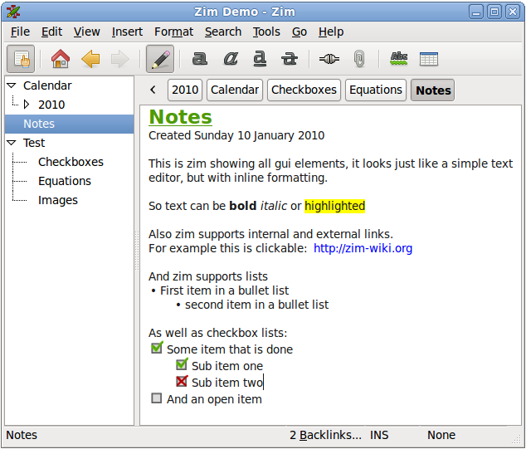
Introducing zim: just a simple text editor
Default view: a page in the notebook
The most basic view: just a page of text, more or less like notepad

Slide 4
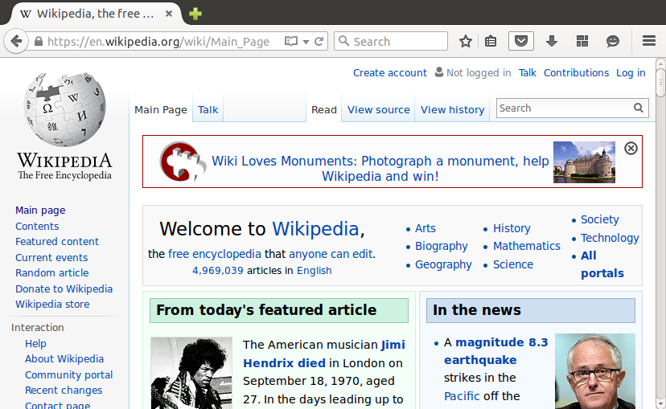
Wait a second – I thought wiki was something else...
Wiki

Slide 5
Wiki is a concept, not a specific website
https://en.wikipedia.org/wiki/WikiWikiWeb
Properties of a wiki:
Easy to edit („wiki wiki“ means „fast“)
Simple text formatting, stored as readable text without (to many) special codes
Structure with multiple pages and hyperlinks (usually page names are in CamelCase)
The best of the „web“ without all the technical hassle
So what does „desktop wiki“ mean ?
It's a desktop application for one user, not a public website (but you can share ..)

Slide 6

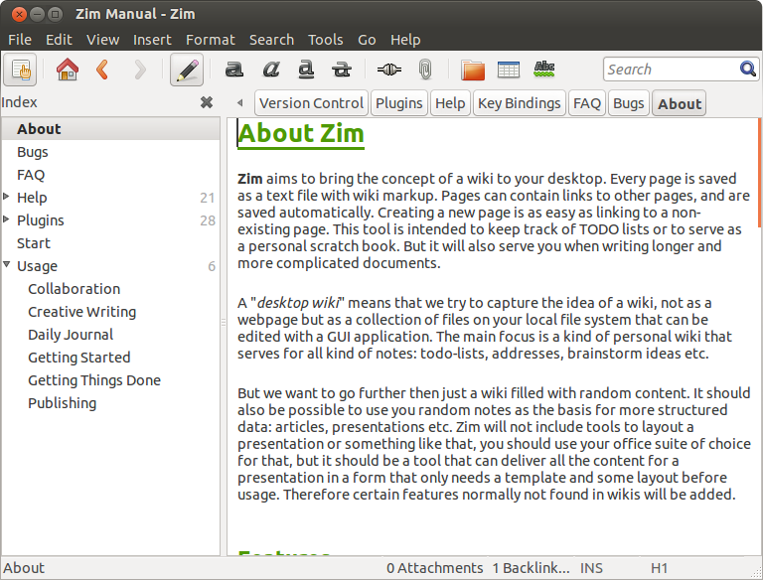
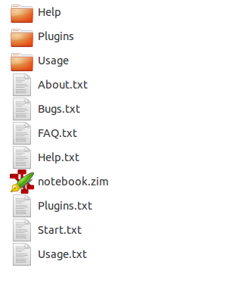
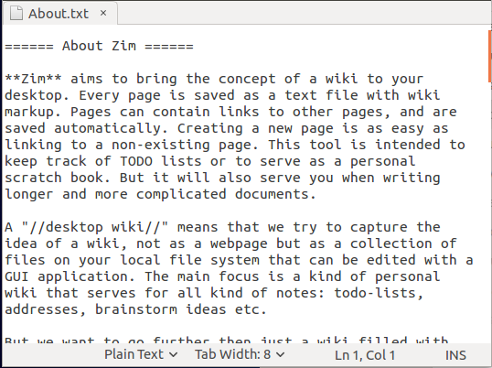
Zim in een nutshell
A desktop application
Structure with multiple files and folders
One user
Text files with simple formatting

Slide 7
Part 1: different ways to organize
A notebook by topic
A journal by day / week / month / ...
Organizing with links, checkboxes & tags
Complate example with project structure & GTD flow
Back to simple: distraction free editing

Slide 8
Exampe 1: a notebook per topic
Demo
Start from scratch
Doesn't get much simpeler – you just create a page per (sub-)topic:
College or work notes
Collections
..
This is how I started with zim: I got this huge load of facts to sort out from different source – how do I handle this?

Slide 9
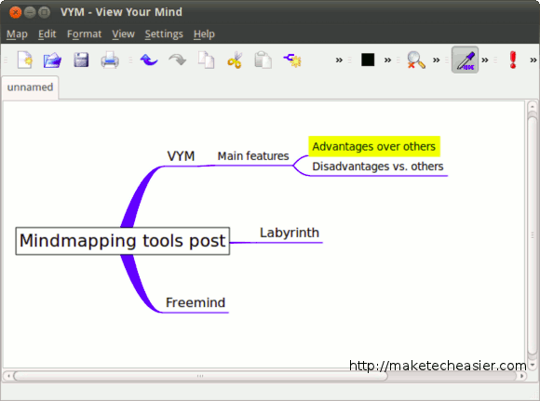
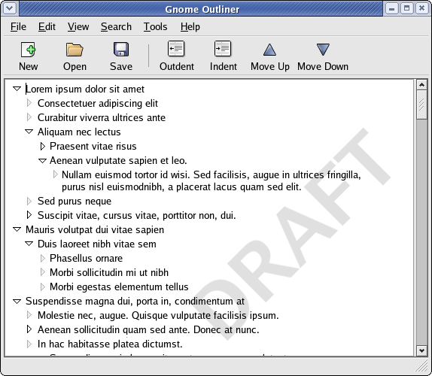
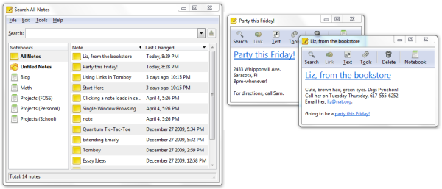

Alternatives
Graphical mindmap tools, another kind of outliner
And many, many, more ...
Outliners: great for brainstorming, doesn't scale for longer, non-hierarchical notes
Ideal if you loe vim or emacs
TomBoy notes: didn't exist yet at the time. The sticky notes format is not structered enough for me.

Slide 10
The goal of zim:
Keep it simple, only add the complixity you need
Just a „notebook“ with text files
No default structure you need to follow
Functional formatting and images, but not as much as an „office“ application
Space and tools to use your own structure and create your own work flow
Often less software is the solution, instead of more

Slide 11
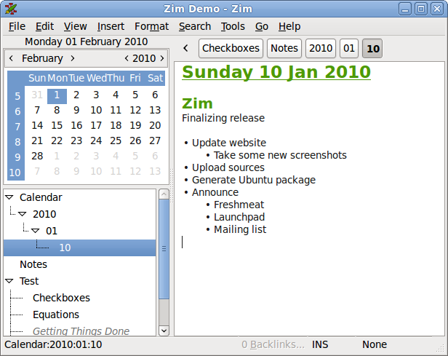
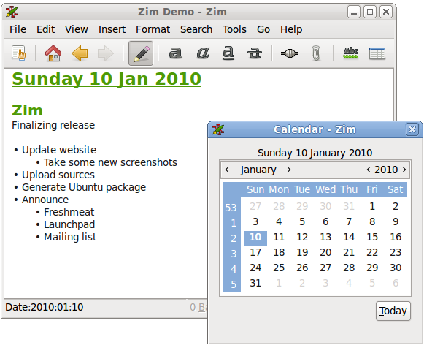
Example 2:
A journal or logbook
Demo
Add journal to demo

Slide 12
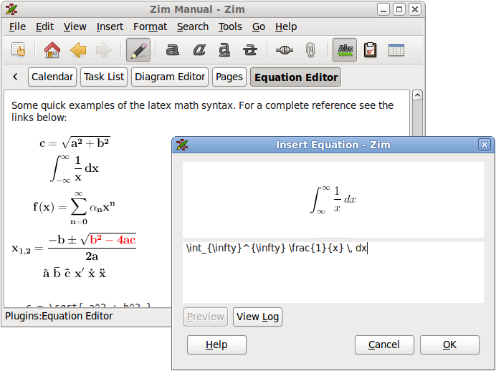
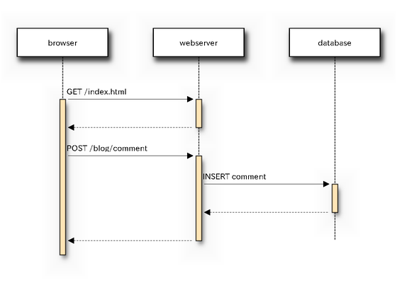
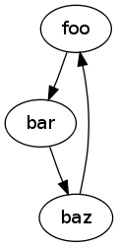
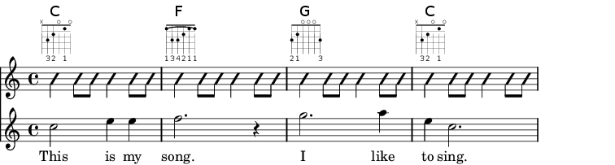
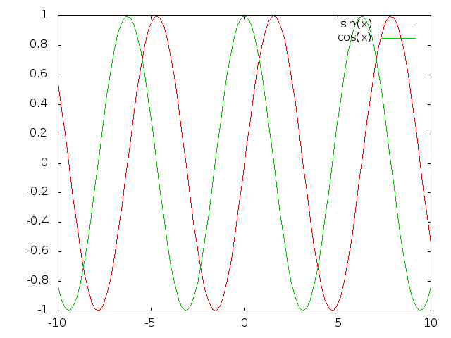
For some information just text is not enough
GraphViz
SeqDiag
Latex
Gnuplot
Lilypond
All these images are generated with external tools based on text input – output embedded in zim pages

Slide 13
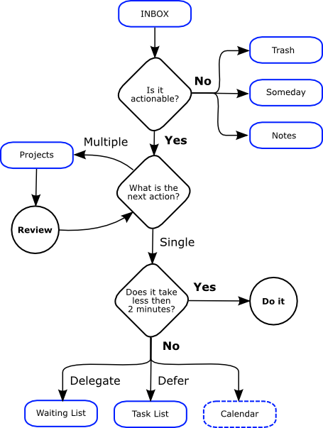

Intermezzo:
Getting Things Done (GTD)
A popular „self management“ method
Helps you think about tasks, action lists and priorities
https://en.wikipedia.org/wiki/Getting_Things_Done

Slide 14
Key elements of GTD
Task lists
  „I've got 10 minutes behind my computer, what can I do?“
  „I'm going shopping tomorrow, anything I forgot last time?“
„Trigger“ lists
  „remind me of this in about 6 months“
Lists with projects and long term goals
  „which things are important to me?“
  Lead to new simple („actionable“) tasks
Lists, lists and more lists

Slide 15
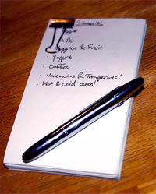
There must be software for that!
„GTD software“ gives more than 800.000 hits on google
(By comparison: „Mindmap software“ about 1.100.000)
However, this is how the paper version looks:
What is the minimal you need to create a GTD work flow in zim?
The „hipster PDA“
http://www.43folders.com/2004/09/03/introducing-the-hipster-pda
http://bulletjournal.com/

Slide 16
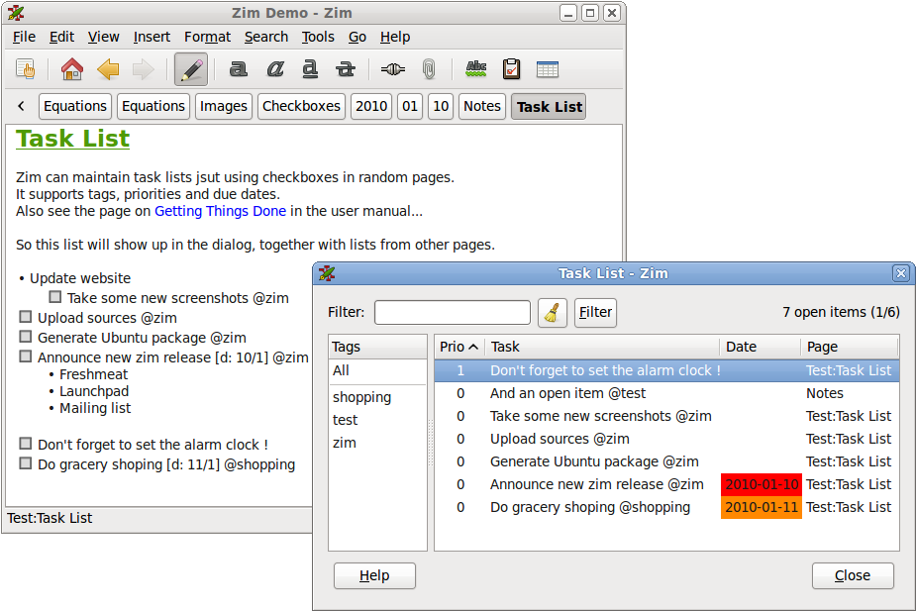
Organizing with links, checkboxes & tags
Demo
Working with task lists
Choose what seems useful:
Links – and back-links !
Checkbox for tasks, dialog with total overview per notebook
Tags to group pages by topic, person, place, ...
It is up to you how you combine these components!

Slide 17
Complete example of project structure & GTD flow
Best practices:
Use the tasklist plugin for actionable tasks
Use the journal plugin for daily or weekly overviews, minutes, etc.
Use several pages for lists of reminders, topics for routine meetings, etc.
If you work on multiple projects: create a section „projects“ with materials per project
Demo

Slide 18
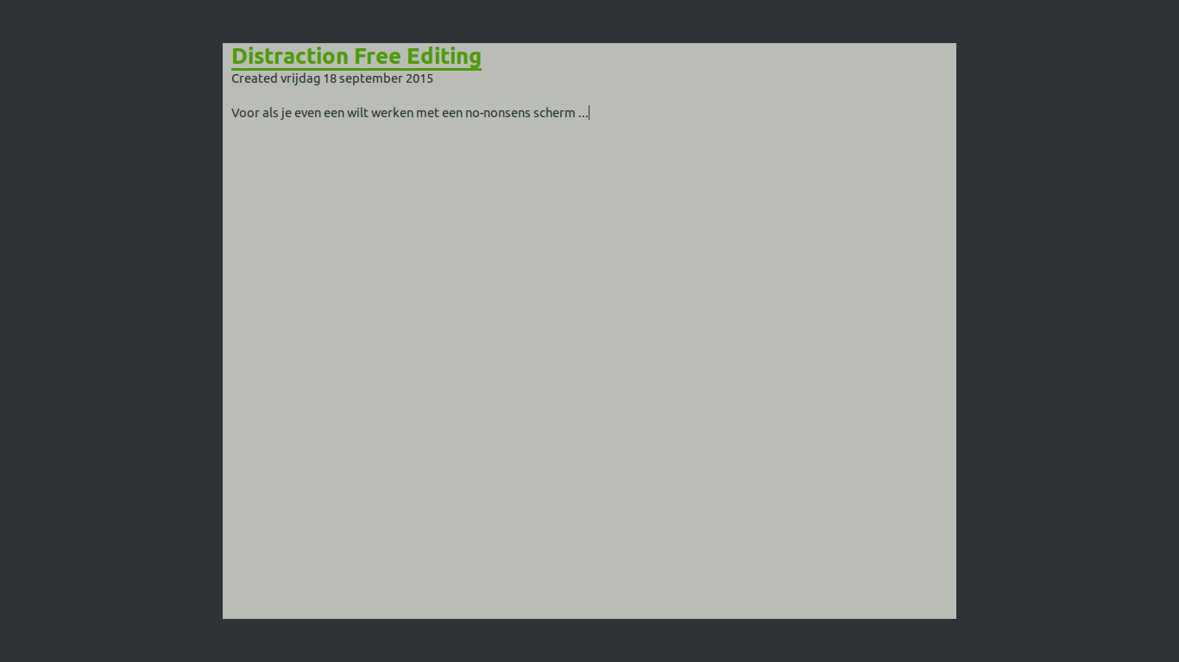
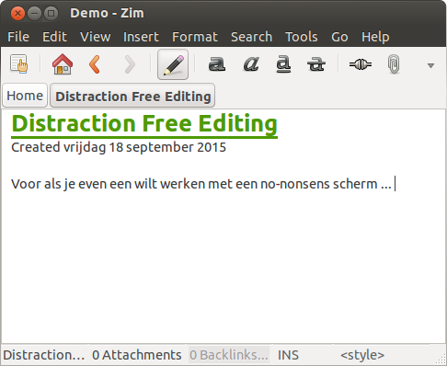
Back to simple: distraction free editing

Slide 19

Zim as scrapbook just try something
Pages & notebooks are „cheap“ – use as many as you need to try something – delete them when done.
For exampel use zim for brainstorming – before you know it a structure starts to emerge
Or just to write something – when a real document structure emerges you can always export the content and continue with other tools

Slide 20
Part 2: customize zim to your own work flow
The possibilities of „free software“
Working with files
Sharing notebooks with others
Custom scripts & Plugins

Slide 21
The Unix way, „Software Libre“ & „Data libre“
The Unix way
  Do one thing and do it well
  Re-use other tools
  Text files as common ground
Free software, free as in freedom
  Open source code that can be changed
  Open data that is not locked in
Software should work for you, not the other way around
To achieve this you need „seams“ in the software that allow modifications

Slide 22
„Seam“in zim
There are 3 ways to change zim
Directly modify the text sources of the notebook – zim will notice the changes and happily continue
Through „custom tools“ – scripts or other applications that are called from within zim
Through plugins – python modules that change the internals of zim

Slide 23
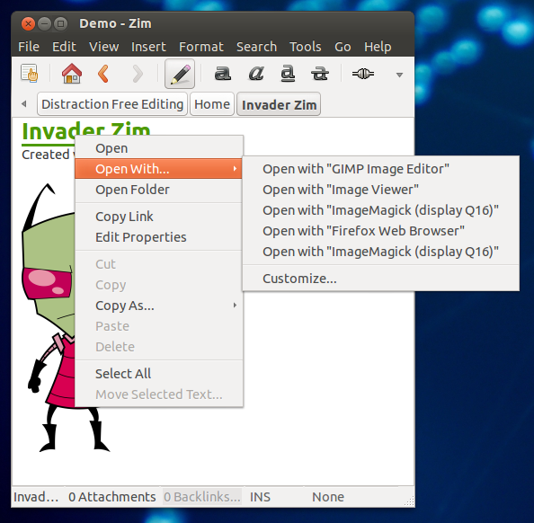
Example of files as a „seam“
Use the rest of your applications

Slide 24
From one to multiple users
Possibilities to work together:
Completely synchronized: DropBox Owncloud
Controlled: Version control, Git and others
Static: export as a website or latex document

Slide 25
Synchronizing notes
Because zim notes are just texts files, you can use any of the standard solutions:
DropBox – not a „free“ solution, but convenient ...
OwnCloud
Your backup program of choice here
Zim is build in the assumption that files can change in the background – however it will not handle the conflicts of multiple users editing the same page

Slide 26



Controlled sharing with version control
The latest generation of version control tools (like Git) are decentralized: copies can be distributed and merged back as you like without the need of a central main version
This is ideal for software source code, but also for notebooks
Old versions of pages remain available in the archive
Changed by different people are easily merged

Slide 27
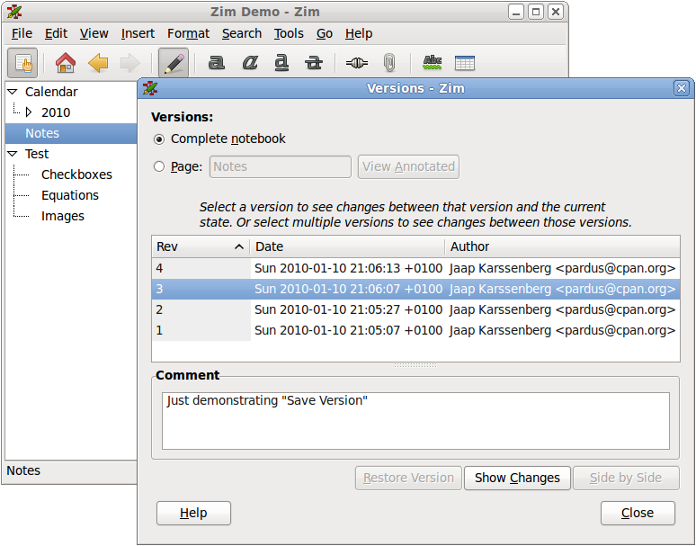
Controlled sharing with version control
The version control plugin can work with:
– Git
– Bazaar
– Fosil
– Mercurial
Dialog with version information
Any other version control system will work as well ! The plugin is just for convenience

Slide 28
Sharing a notebook as a website
Demo
Also here there are different options:
Static HTML exported from zim
Live server from zim
CGI-BIN wrapper in webserver
In all cases you can use templates for export
When you re-build a static website with some frequency „the Unix way“ would be to write a „make“ script that calls zim instead of using the dialog..

Slide 29
Custom tools
Demo
https://github.com/jaap-karssenberg/zim-wiki/wiki/Text2mindmap-custom-tool
„Custom tools“ are scripts or applicationgs that act directly on the text files but are called from within zim. I kind of shortcut in the toolbar.
Examples of tools can be found in the wiki
A “mindmap” creation tool
Text „re-flow“ by removing line breaks – to be used for example after copy-pasting an email
Download a linked website
Move tasks from the current page to tomorrow's journal page
Count words by notebook sections – useful when drafting documents like short stories

Slide 30
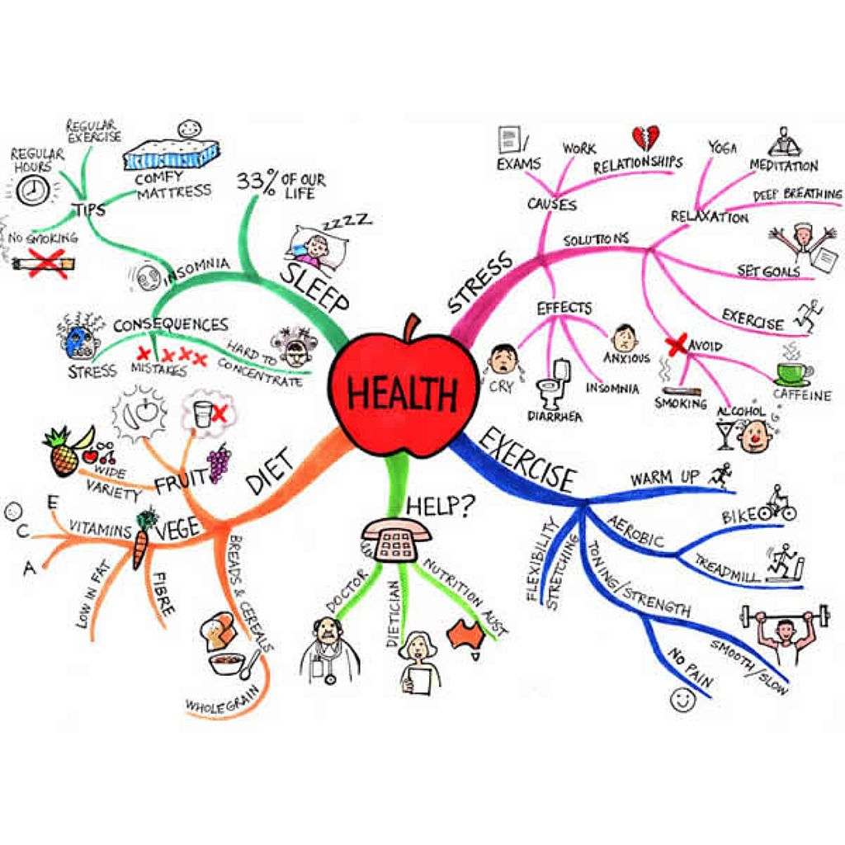
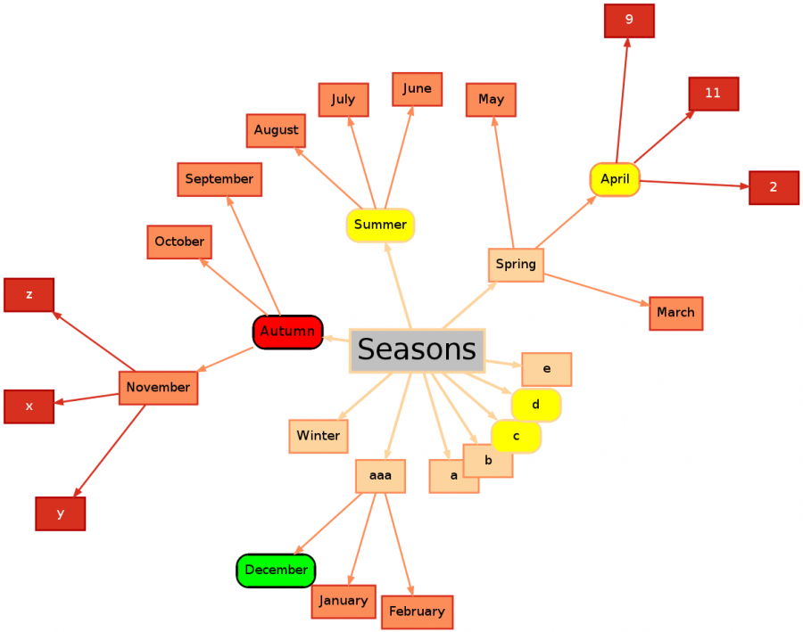
Intermezzo: What is a mindmap ?
Common technique to map information
Useful for brainstorming
Useful to map your own knowledge of a topic
Uses visual memory: colors, drawings, etc.
Manual: use a whiteboard
Software: to many choices, try freemind as an example

Slide 31
Plugins
Demo
Laat standaard plugins zien
Any cool ideas?
Plugins are one step further, especially useful to add functions that need to modify the user interface
Plugins are always python modules
In principle they can access and change any object in zim
A few „entry points“ are defined like the window, dialogs, and the notebook object
A long list of plugins is already included in the package, ideas for new plugins can be found in the wiki

Slide 32
What if you don't like computer code ?
Write down and clarify your own work flow
  What is the goal, what are you trying to do?
  What are the logical steps to get there?
  What overviews would you need?
  Is it really personal, or more generally useful?
Discuss with others – how do they organize things?
Describe what you are missing step by step
  Zim is a hobby for me – the more precise you describe what you want, the easier for me to write some quick code
Help out with translations and documentation

Slide 33

Questions ?
Jaap.Karssenberg@gmail.com

Slide 34
Software should work for you, not the other way around
Often less software is a better solution than more software
Free software has „seams“ that allow you to watch behind the screen

